Slide 1



WPF PANELS
Proiect medii vizuale de programare
Dobre Cosmin
Edves Alexandru

Slide 2
CUPRINS
01
02
CE SUNT WPF PANELS ?
TIPURI DE WPF PANELS

Slide 3


01
CE SUNT WPF PANELS ?

Slide 4
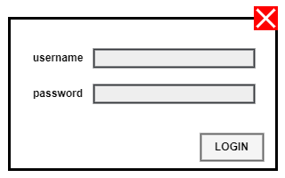
WPF PANEL
Este un element grafic care poate conține alte elemente grafice (butoane, imagini, etc).

Slide 5
02
TIPURI DE WPF PANELS

Slide 6
TIPURI DE WPF PANELS
WRAP PANEL
DOCK PANEL
GRID SPLITTER
START
FINISH
CANVAS
STACK PANEL
GRID

Slide 7
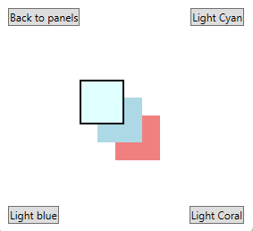
CANVAS
Sintaxa:
<Window>
<Canvas>
…
</Canvas>
</Window>
Notes:
The Canvas is probably the simplest Panel of them all. It doesn't really do anything by default, it just allows you to put controls in it and then position them yourself using explicit coordinates.

Slide 8
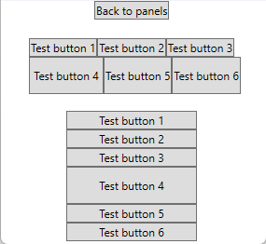
WRAP PANEL
Sintaxa:
<Window>
<WrapPanel>
…
</WrapPanel>
</Window>
Notes:
The WrapPanel will position each of its child controls next to the other, horizontally (default) or vertically, until there is no more room, where it will wrap to the next line and then continue. Use it when you want a vertical or horizontal list controls that automatically wraps when there's no more room.

Slide 9
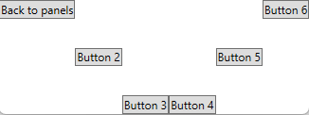
STACK PANEL
Sintaxa:
<Window>
<StackPanel Orientation=“…”>
…
</StackPanel>
</Window>
Notes:
The StackPanel is very similar to the WrapPanel, but with at least one important difference: The StackPanel doesn't wrap the content. Instead it stretches it content in one direction, allowing you to stack item after item on top of each other. Let's first try a very simple example, much like we did with the WrapPanel:

Slide 10
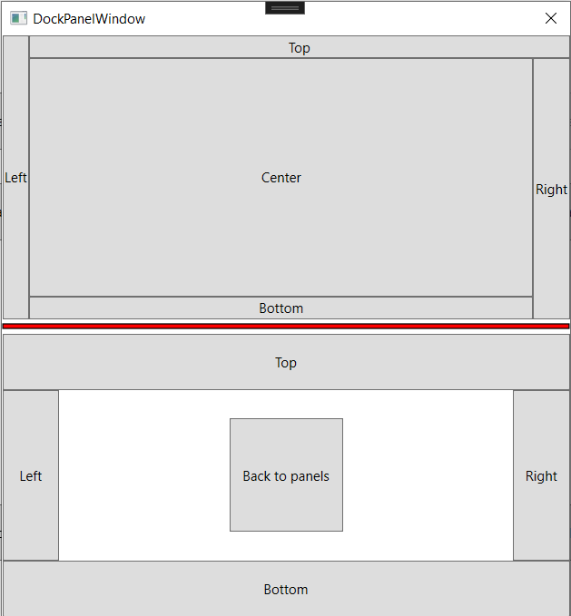
DOCK PANEL
Sintaxa:
<Window>
<DockPanel>
…
</DockPanel>
</Window>
Notes:
…

Slide 11
GRID PANEL
ROWS & COLUMNS
SPANNING
CONTROL
UNITS

Slide 12
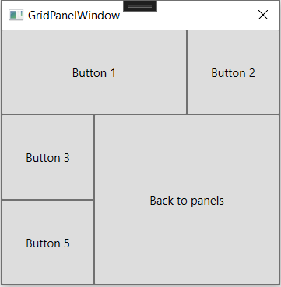
Sintaxa:
<Window>
<Grid>
<Grid.ColumnDefinitions>
…
</Grid.ColumnDefinitions>
<Grid.RowDefinitions>
…
</Grid.RowDefinitions>
<Button Grid.ColumnSpan=“…“>
<Button Grid.Column=“…“>
<Button Grid.Row=“…">
…
</Grid> </Window>
Notes:
…

Slide 13
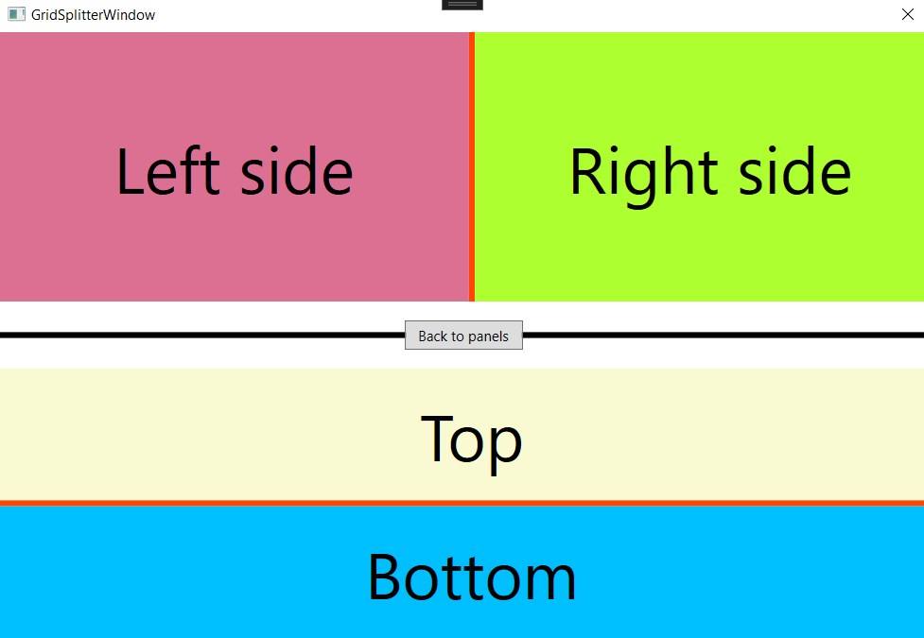
GRIDSPLITTER
Sintaxa:
<Window>
<Grid>
<Grid.ColumnDefinitions>
…
</Grid.ColumnDefinitions>
<GridSplitter ... />
</Grid>
</Window>
Notes:
…

Slide 14
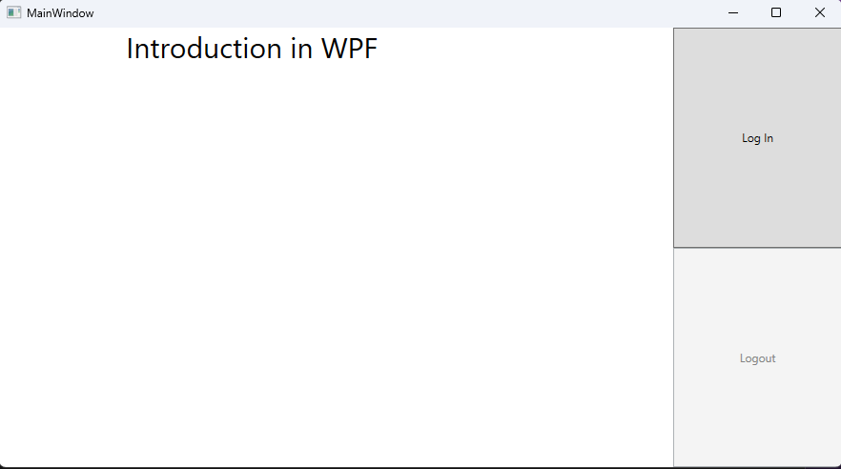
DESKTOP APPLICATION

Slide 15
THANKS!

